Slide 1


GOOD
PROGRAMMING
PRACTICES

Slide 2

Inception
Developing good programs is a skill and writing good programs is a habit.
Good programming practices are techniques to be followed to create code that is readable and efficient.
This makes it easier to read and modify code written by others.
Effective
Efficient
Readable
Reliable
Usable
Portable

Slide 3
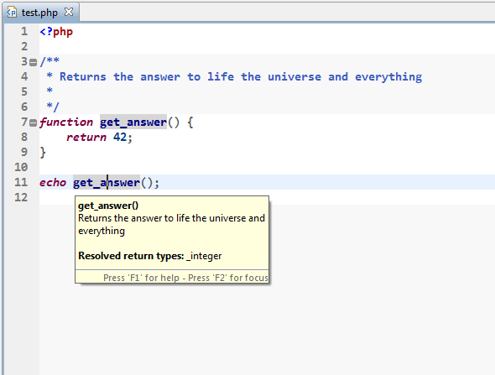
COMMENTING
Code should be properly commented for better understanding of a program.Comments regarding the statements increase the understability of the code.

Slide 4
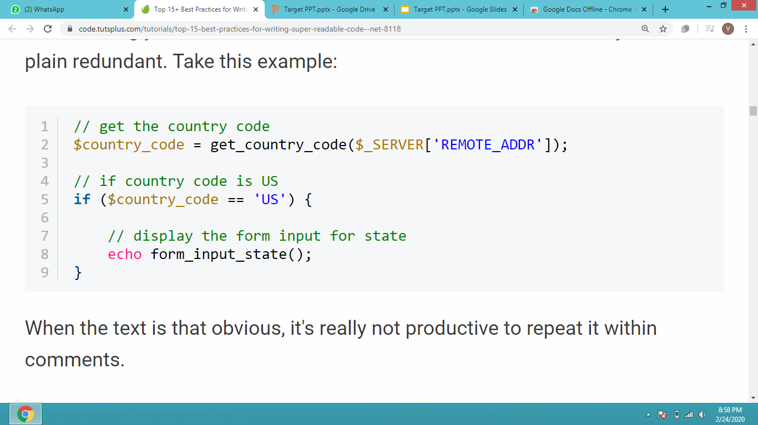
AVOIDING OBVIOUS COMMENTS
Commenting your code can help in better understanding but it should not be overdone or made redundant.Obvious understandable statements doesn’t require comments.

Slide 5
INDENTATION
Indentation increases readability of the code.
Some of the spacing conventions are given below:
There must be a space after giving a comma between two function arguments.
Each nested block should be properly indented and spaced.
All braces should start from a new line and the code following the end of braces also start from a new line.

Slide 6
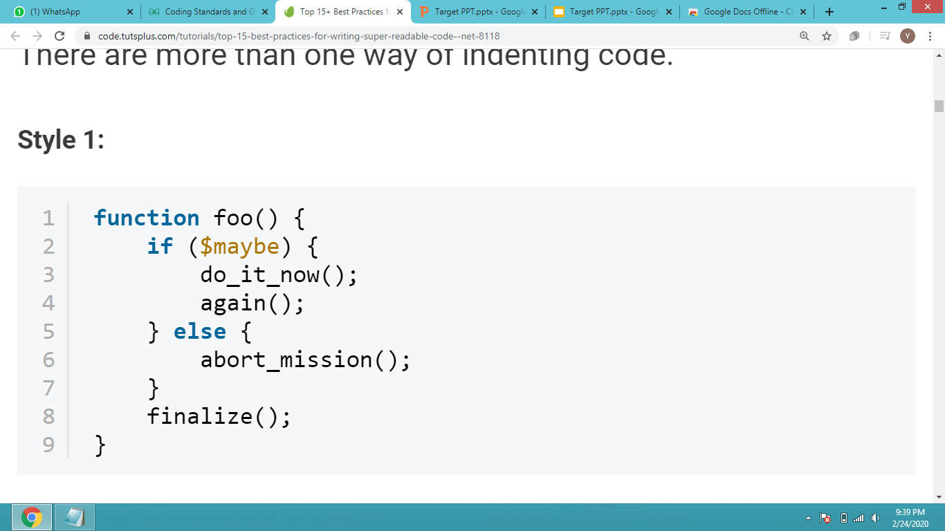
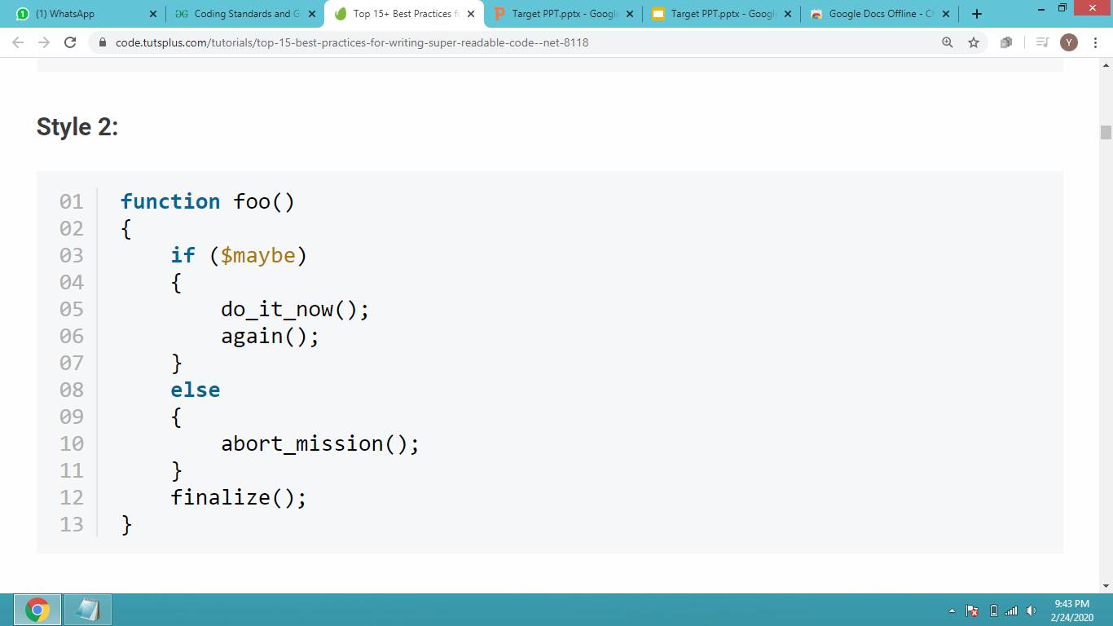
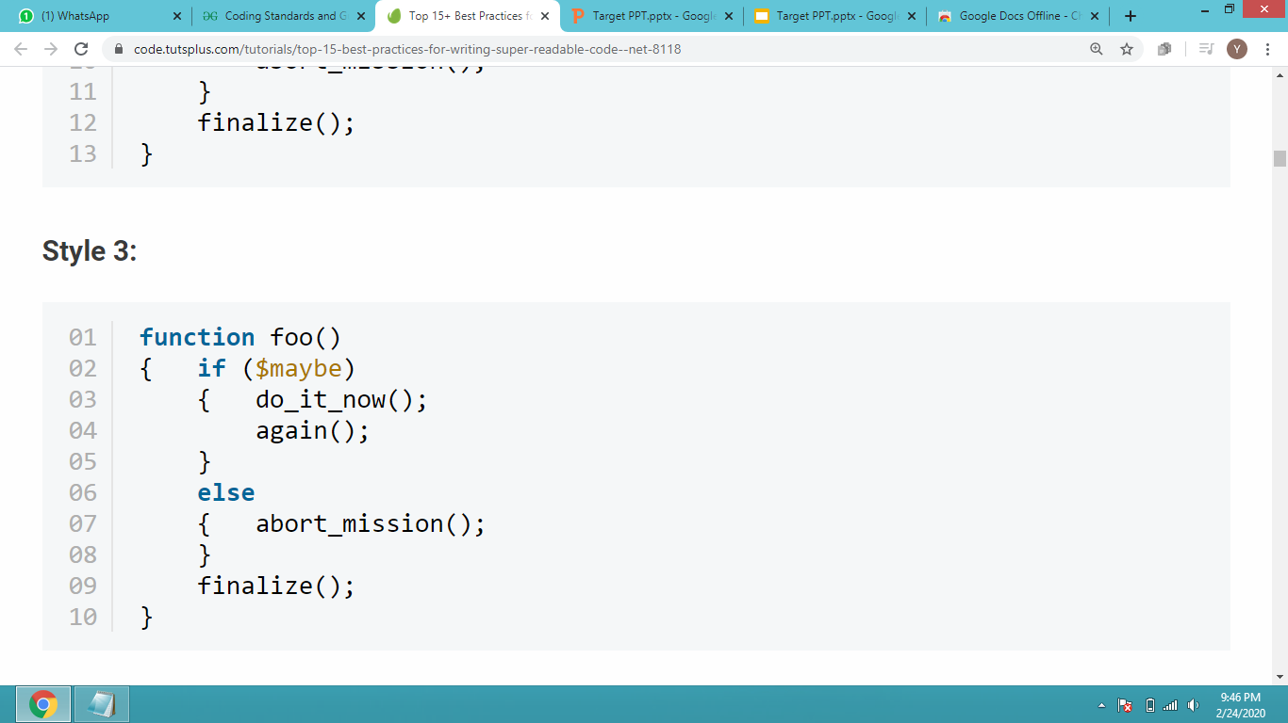
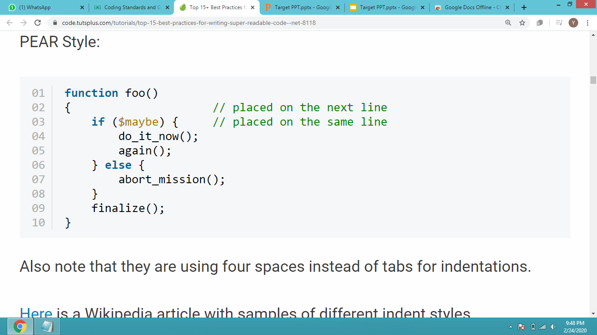
INDENTATION STYLES

Slide 7
CODE REUSABILITY
Reusable code is the use of similar codes in multiple functions. But it doesn’t mean COPYING AND PASTING the code. Instead it is the methodology to use similar code without having to rewrite.
In OOPS inheritance property provides the idea of reusability where in we add additional features to an existing class without modifying it.
While developing a software instead of building it from scratch a small fraction of reusing the code from different projects help.

Slide 8
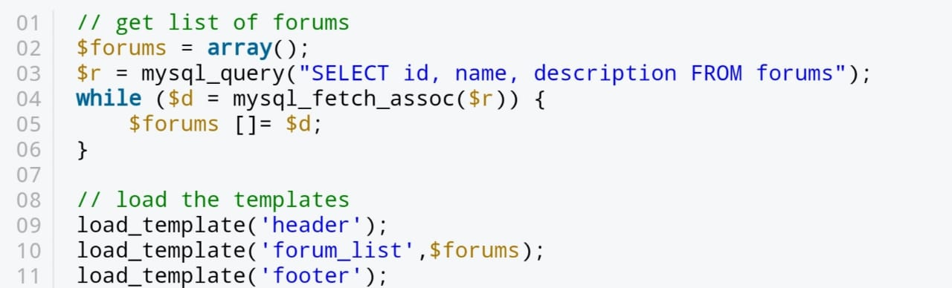
CODE GROUPING
Certain tasks require a few lines of code so it’s a good idea to keep them within separate code blocks with few spaces between them.
We can add comment at the starting of each block to emphasize visual separation.

Slide 9
CONSISTENT NAMING SCHEME
There are 2 options available:
1.camelCase : First letter of each word is capitalized except the first word eg: someDummyMethod()
2.underscores : to join 2 or more words so that theres no spaces between them eg:Foo_bar
There is a possibility that both the naming schemes are mixed in a paricular program.
Java mostly uses camelCase names.
PHP mostly uses underscores.

Slide 10
CONSISTENT NAMING SCHEME
Meaningful and understandable variable names helps to understand the reason for using it.
Local variables should be named using camel case lettering starting with small letter (e.g. localData) whereas Global variables names should start with a capital letter (e.g. GlobalData). Constant names should be formed using capital letters only (e.g. CONSDATA).
The names of the function should be written in camel case starting with small letters.
The name of the function must describe the reason of using the function clearly and briefly.

Slide 11
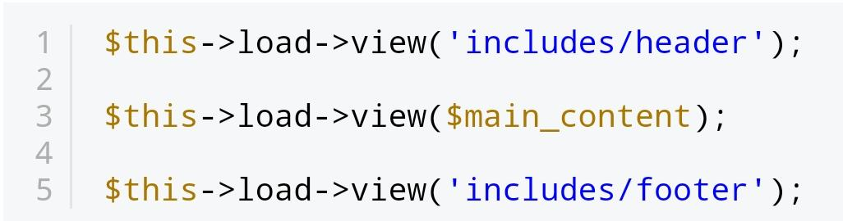
DRY PRINCIPLE
DRY means Dont Repeat Yourself also known as DIE : Duplication is Evil
It states that “every piece of knowledge must have single,unambiguous,authoritative representation within a system”.
In short the same code should not be repeated n times.This is a code snippet of how to create template in CodeIgniter.

Slide 12
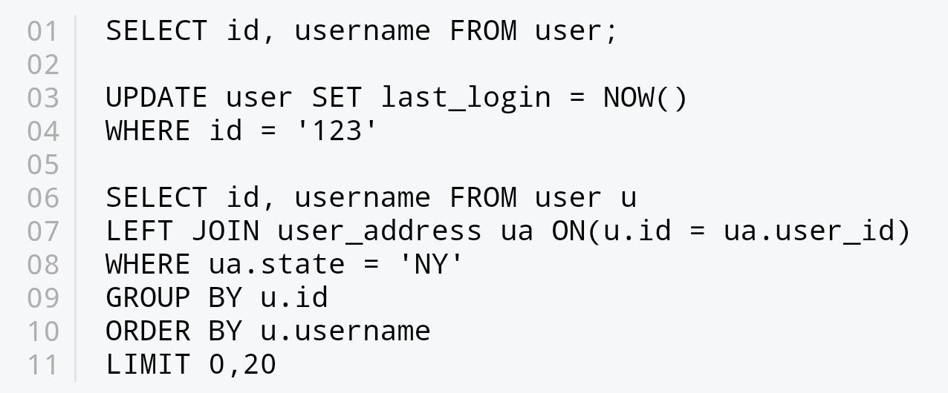
CAPITALIZE SQL SPECIAL WORDS
Database interaction is a big part of most web applications. SQL queries must be kept readable so its a common practice to capitalize them to distinguish them from table and column names.

Slide 13
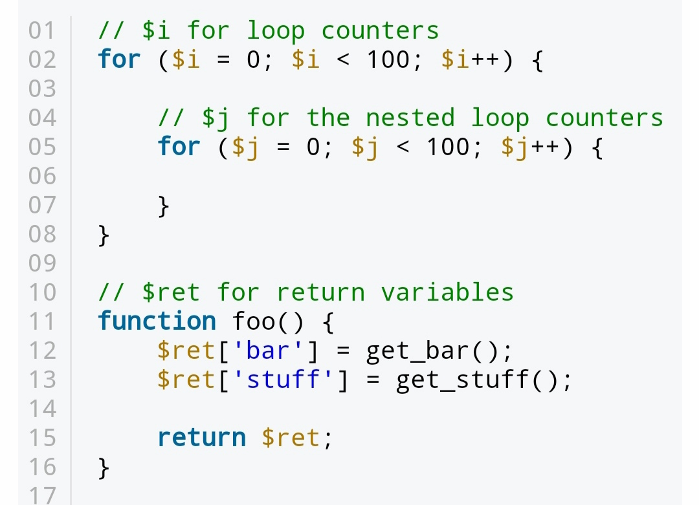
CONSISTENT TEMPORARY NAMES
Normally, the variables should be descriptive and contain one or more words. But, this doesn't necessarily apply to temporary variables. They can be as short as a single character.

Slide 14
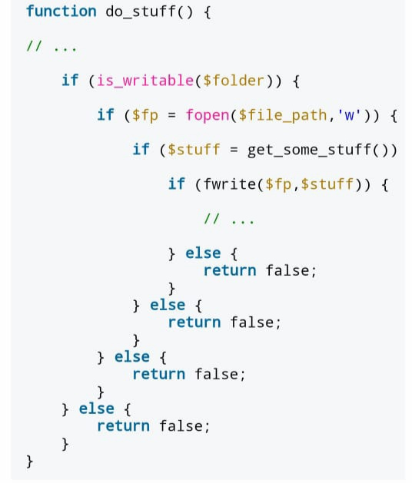
AVOID DEEP NESTING
Too many levels of nesting can make code harder to read and follow.

Slide 15
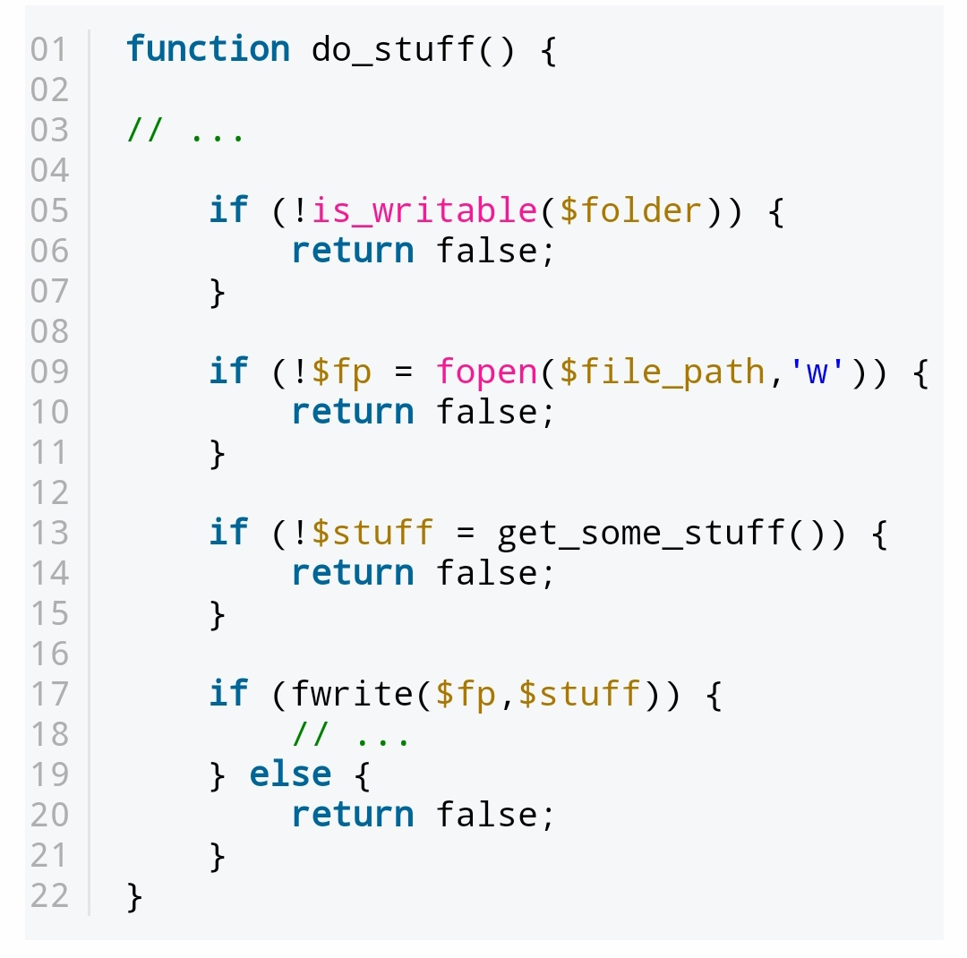
For the sake of readability, it is usually possible to make changes to your code to reduce the level of nesting:

Slide 16
LIMIT LINE LENGTH
Our eyes are more comfortable when reading tall and narrow columns of text.
It is a good practice to avoid writing horizontally long lines of code.

Slide 17
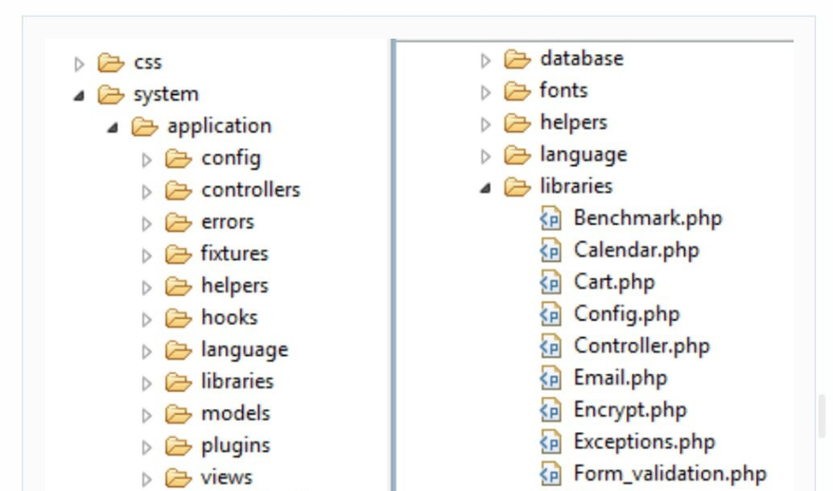
FILE AND FOLDER ORGANIZATION
When we are writing a huge code for an application it cannot be in a single file because it looks to huge .So we split in such a way that the related files come under the same name and similarly folders for easier access and viewing.

Slide 18
AVOID GOTO
It is a control statement used to jump to specific point in the code . Goto statement makes program unstructured , thus reduces understandability of program
DISADVANTAGES OF USING GOTO
Confusing code
Infinite loop
Reduces readability

Slide 19
AVOID REDUNDANT LABELLING
Labels are like goto statements . Use them sparingly and only when they make code faster and more understandable.
It is a good programming style to use break , continue and return statement in preference to goto and labels whenever possible

Slide 20
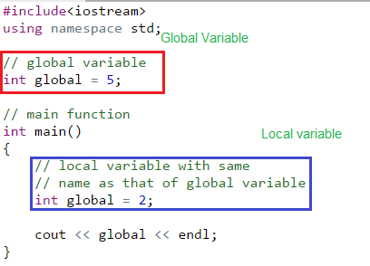
LIMITED GLOBALS
Global variables can be accessed throughout the program.
Unprotected data : data can be modified by any function.

Slide 21
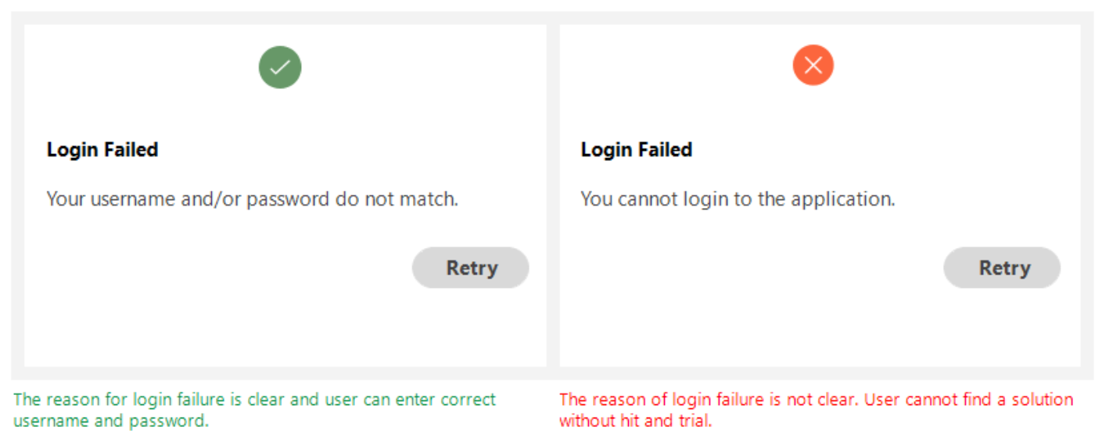
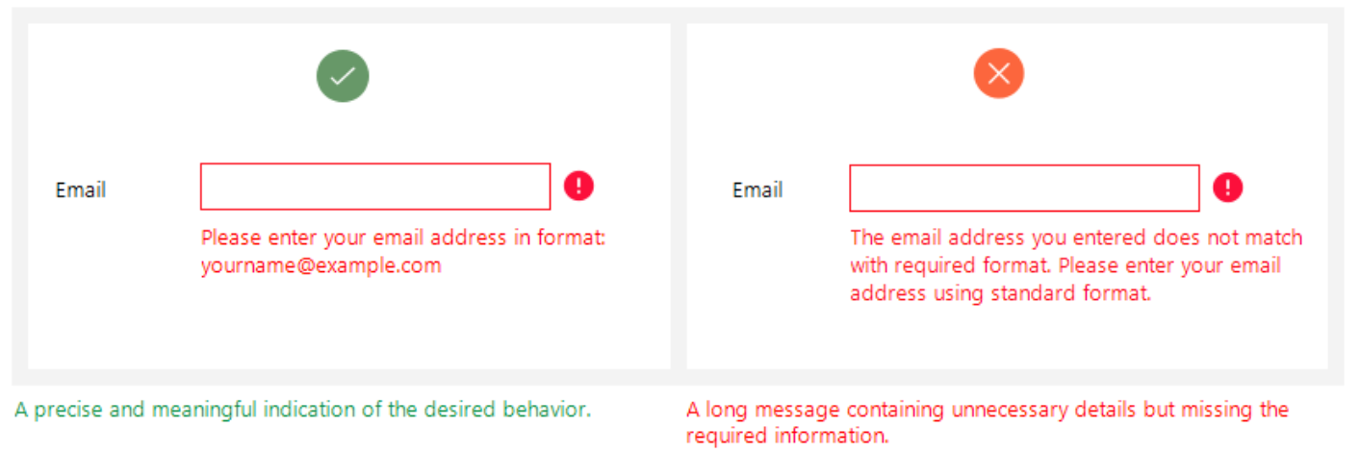
USEFUL ERROR MESSAGES
Be clear and not ambiguous
Be short and meaningful

Slide 22
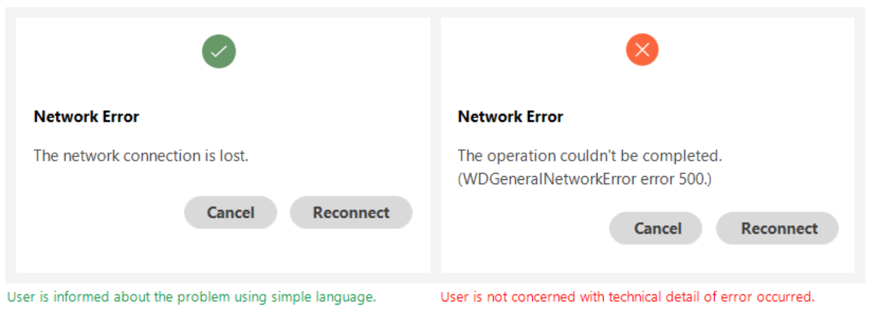
USEFUL ERROR MESSAGES
Don’t use technical jargons

Slide 23
OPTIMIZATION V/S READABILITY
Premature optimization really is evil
int SimpleMultiplyBy2(int x) { return x * 2; }
int FastMultiplyBy2(int x) { return x << 1; }

Slide 24
DATA CODE SEPARATION
Permissions
Editing
Scaling
searching

Slide 25
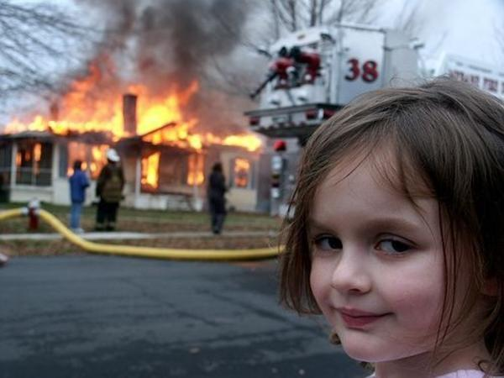
I DO SOFTWARE DEVELOPMENT
Don’t use technical jargon
EXCEPT EXCEPTION HANDLING

Slide 26
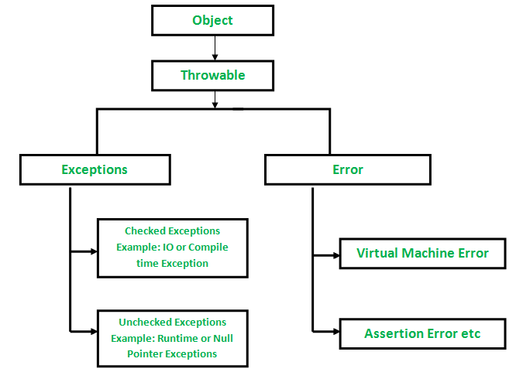
EXCEPTION HIERARCHY
Don’t use technical jargon

Slide 27
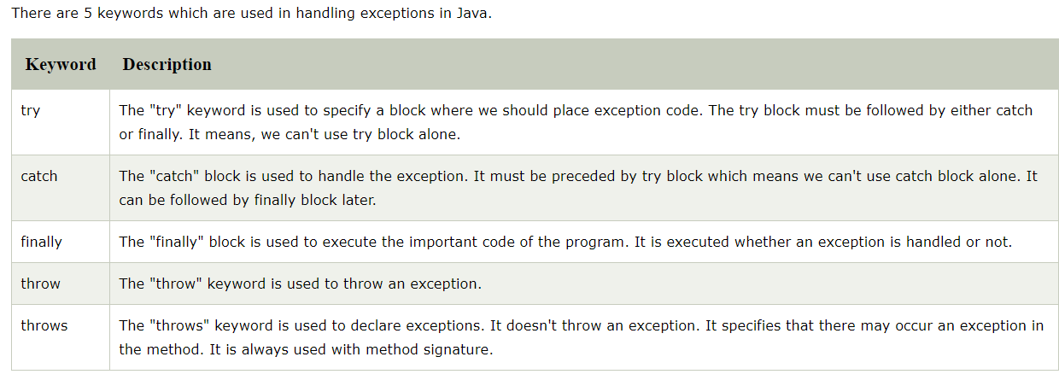
Java Exception Keywords

Slide 28
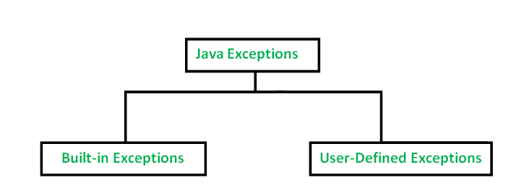
Don’t use technical jargon

Slide 29
BUILT IN EXCEPTIONS IN JAVA
ArithmeticException
ArrayIndexOutOfBoundsException
ClassNotFoundException
FileNotFoundException
IOException
InterruptedException
NoSuchFieldException
NoSuchMethodException
NullPointerException
NumberFormatException
RuntimeException
StringIndexOutOfBoundsException

Slide 30
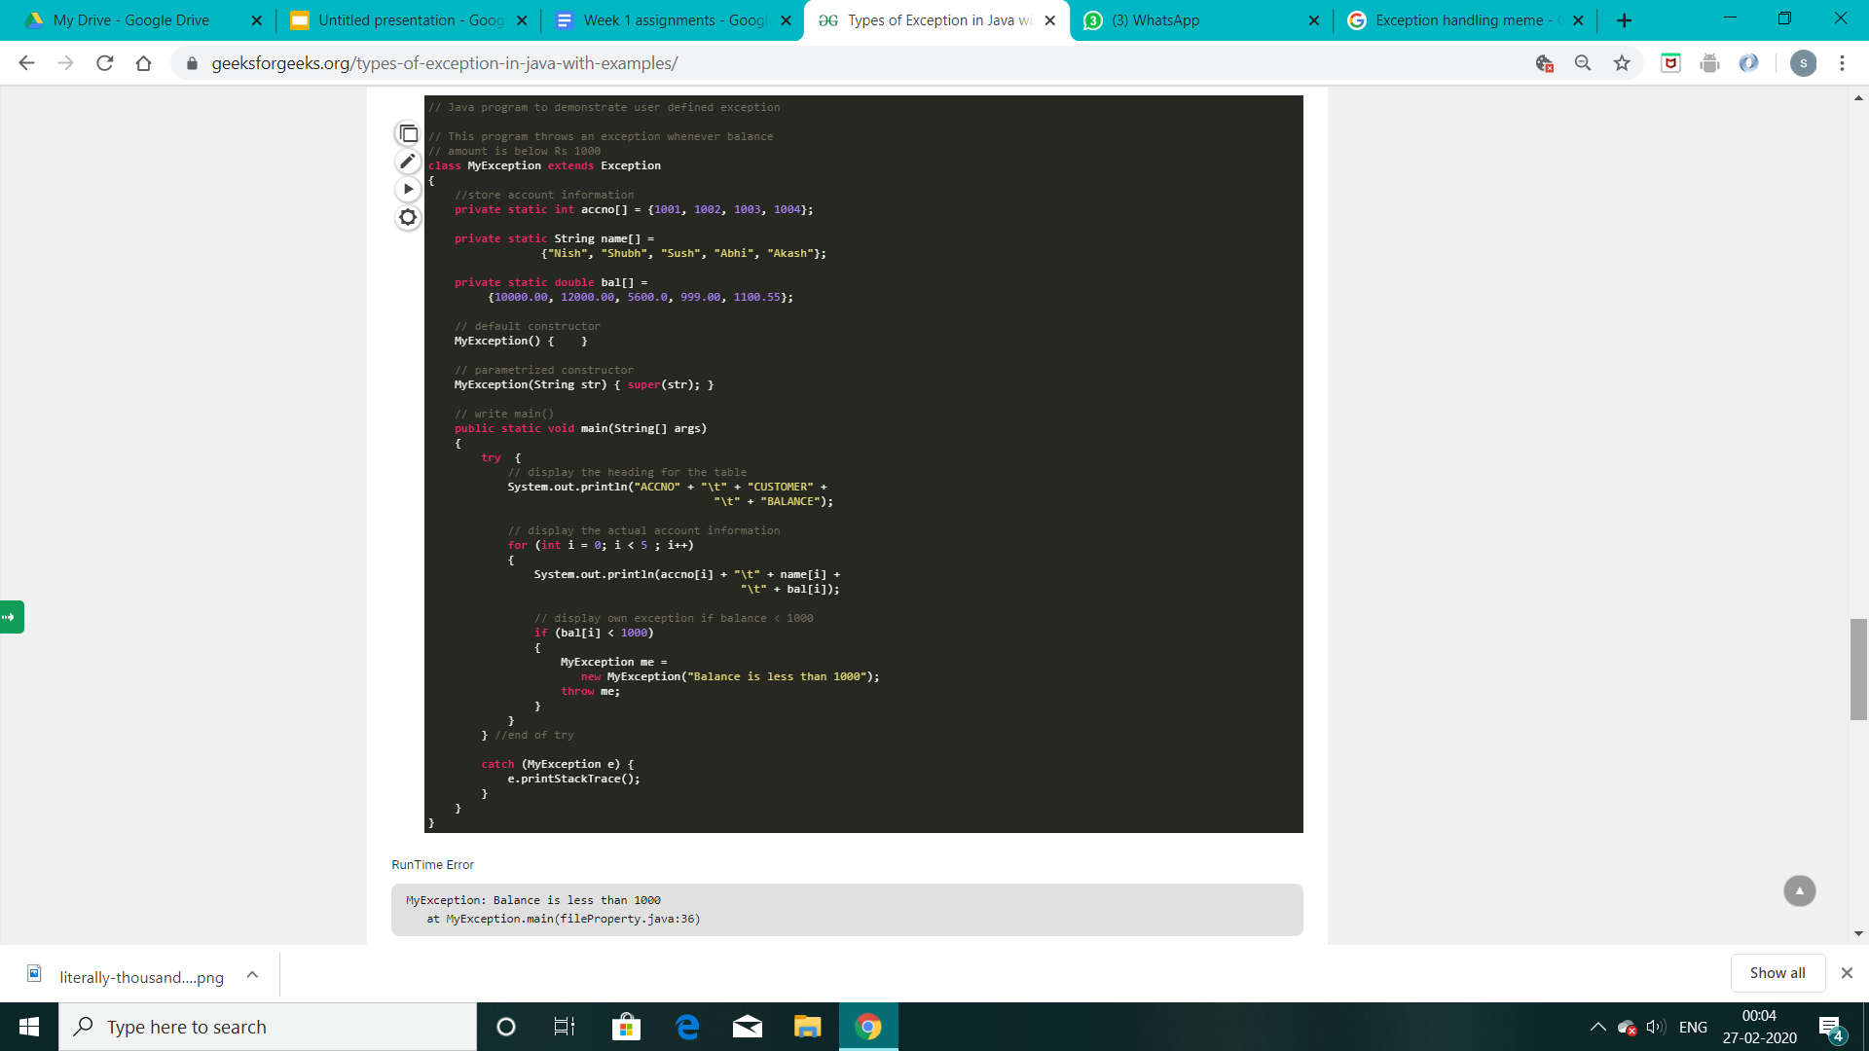
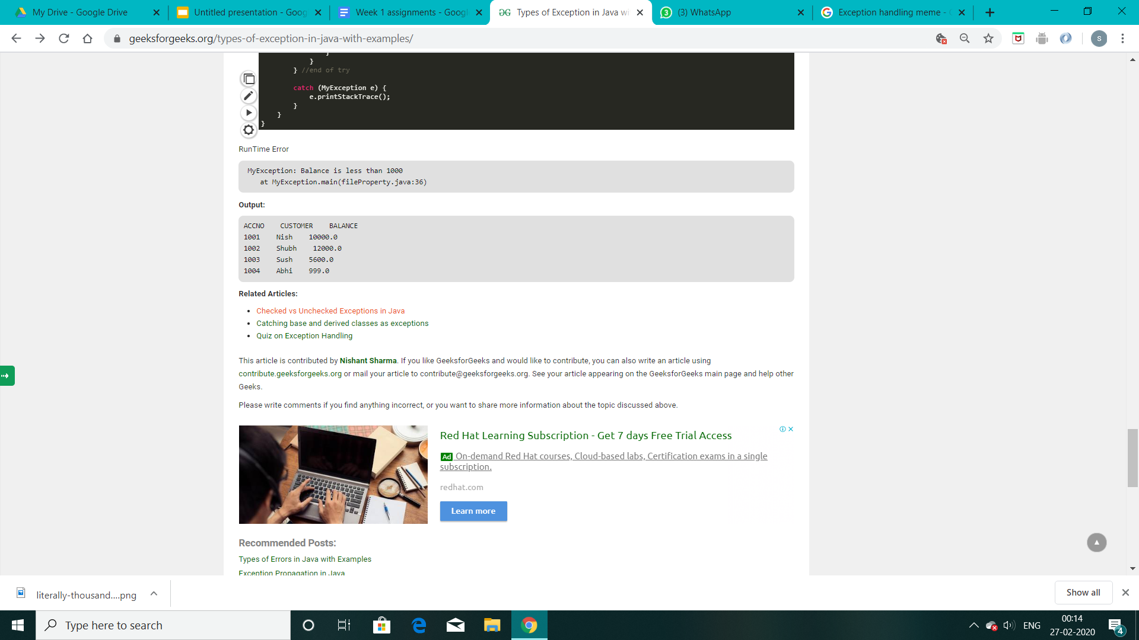
User-Defined Exceptions
The user should create an exception class as a subclass of Exception class
class MyException extends Exception
We can write a default constructor in his own exception class.
MyException(){}
We can also create a parameterized constructor with a string as a parameter.
MyException(String str)
{
super(str);
}
To raise exception of user-defined type, we need to create an object to his exception class and throw it using throw clause, as:
MyException me = new MyException(“Exception details”);
throw me;

Slide 31

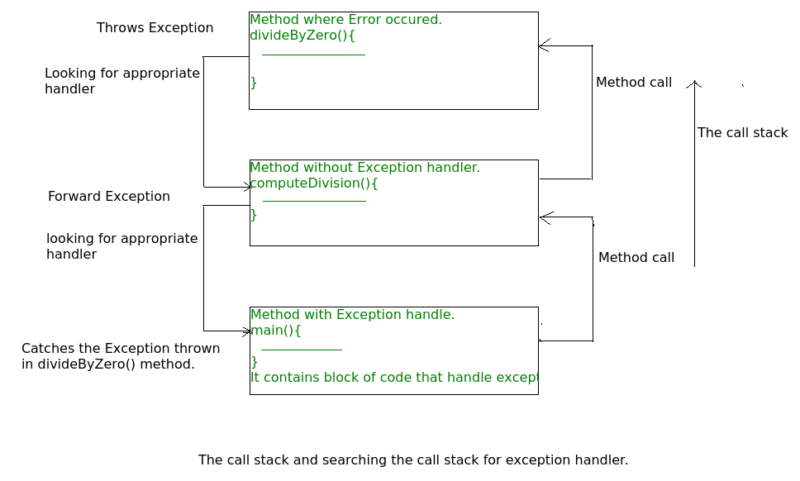
The Call Stack And Searching The Call Stack For Exception Handler

Slide 32
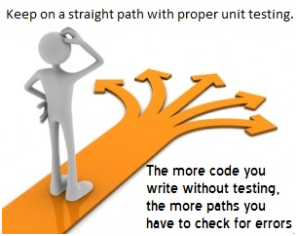
UNIT TESTING

Slide 33
OBJECT ORIENTED VS. PROCEDURAL
Object Orientation is a programming paradigm that helps you create well structured code.
OOP benefits:
Modularity for easier troubleshooting
Reuse of code through inheritance
Flexibility through polymorphism
Effective problem-solving
But that does not mean you need to abandon procedural programming completely. Procedural programming can be helpful when there is less overhead and manageable lines of code.
Actually creating a mix of both styles can be good.

Slide 34
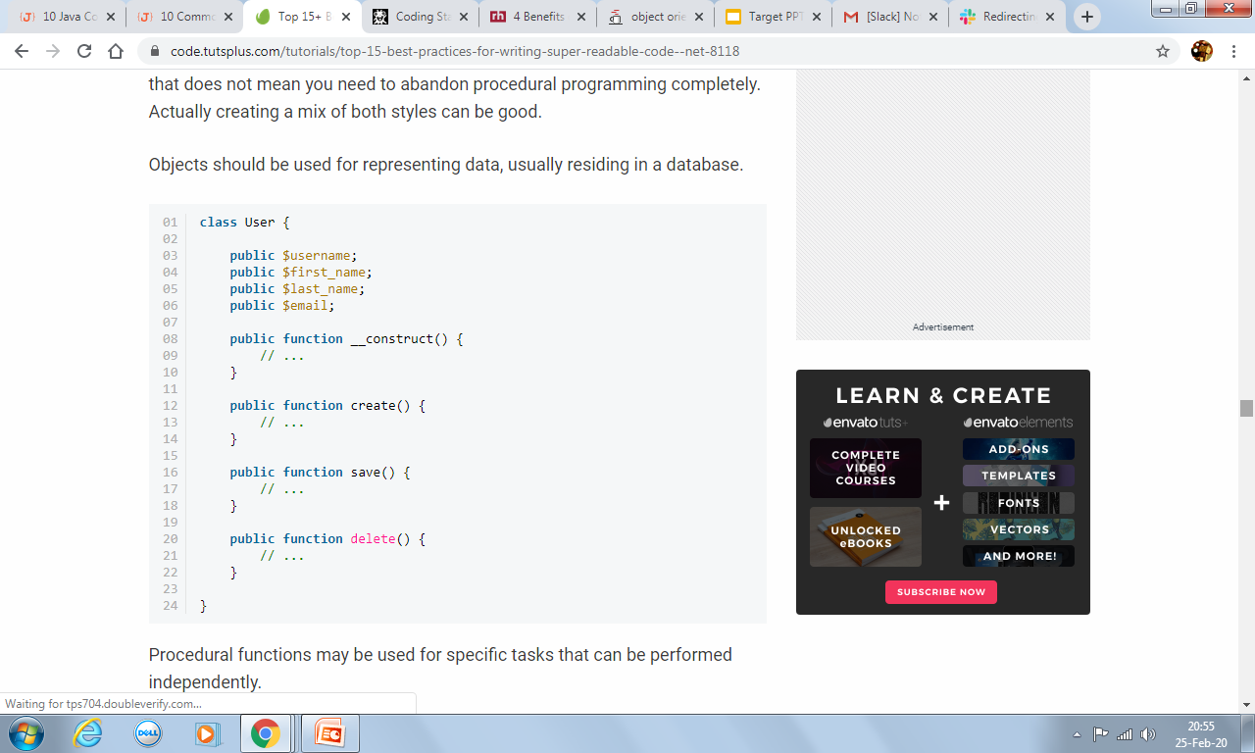
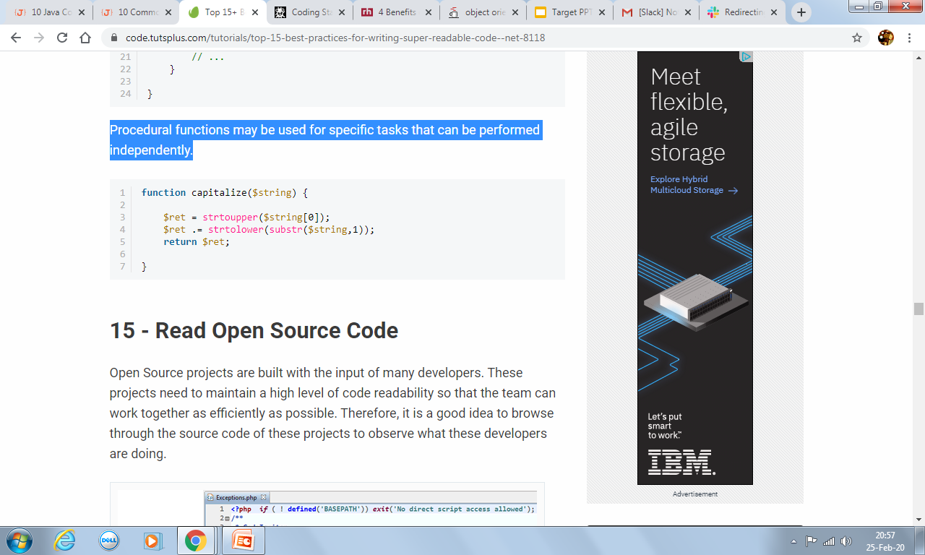
For eg. Objects can be used to represent data usually residing in databases:
Procedural functions may be used for specific tasks that can be performed independently:

Slide 35
CODE REFACTORING
Code refactoring is a process that involves editing and cleaning up previously written code without changing the function of the code at all. It makes it easier to maintain, easier to understand, easier to identify defects, remove unused code and optimise the performance.
This includes:
Remove unnecessary code and test cases
Delete rather than commenting
Refactor & Improve
Use tools effectively
Review your code
Testing

Slide 36
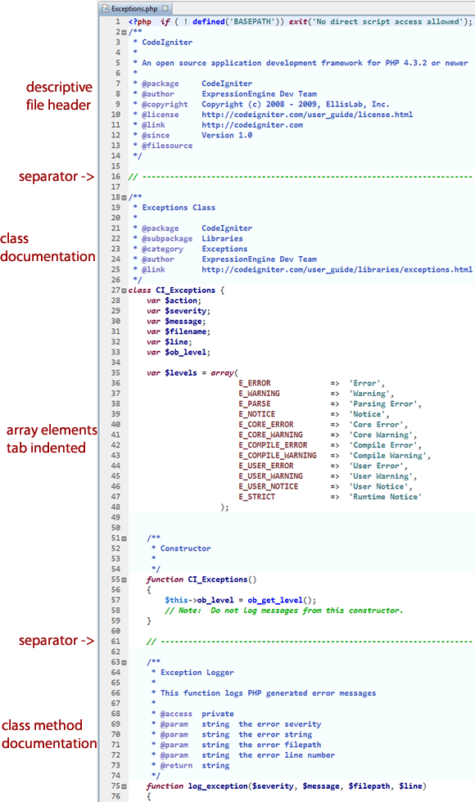
READ OPEN SOURCE CODE

Slide 37
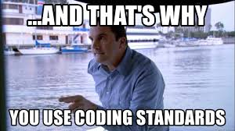
BENEFITS OF GOOD PROGRAMMING PRACTICES
Quicker to debug code
Easier to code review work
Enhanced Efficiency
Minimal Complexity
Easy to Maintain
A Comprehensive Look
Cost-Efficient
Risk of project failure is reduced

Slide 38
“We like to think we spend our time power typing, but we actually spend most of our time staring into the abyss”
- Douglas Crockford (principle discoverer of JSON, creator of JSLint)
T
H
A
N
K
Y
O
U

